Slide 1

Our school

Slide 2
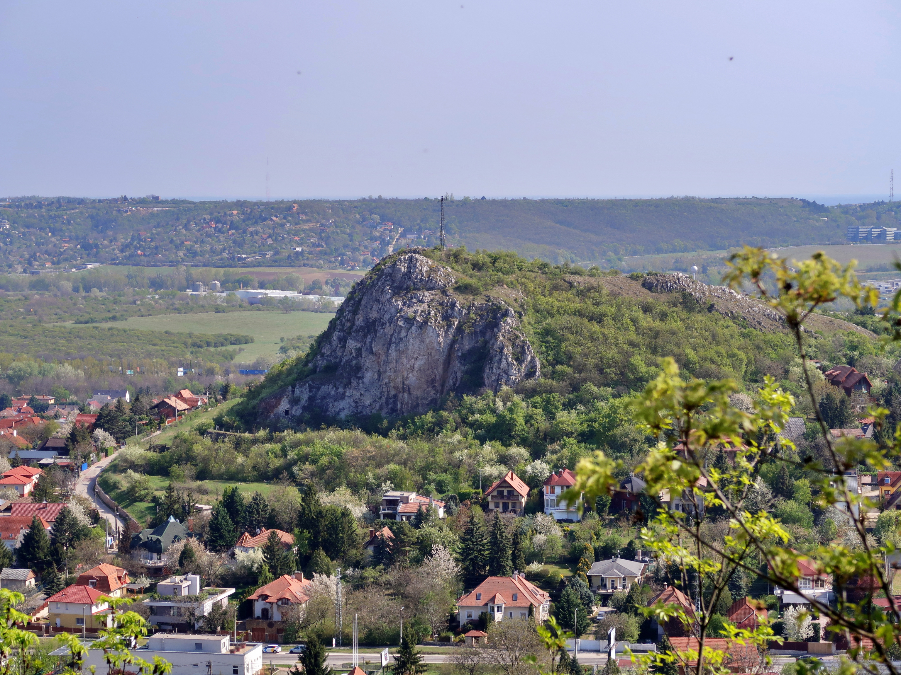
Our school:
This school is located next to the capital city of Hungary (Budapest) in Budaörs along the Budai-mountains
In this school we have maximum of 8 classes
A class takes 45-minutes
We have a big launch break whit 40minutes and a 20-minute for ten o'clock snack (others are 10 and 5-minutes)
On some pe classes we go ice skating or swimming
We also have a class for making the homework at the end of the day accept Friday

Slide 3
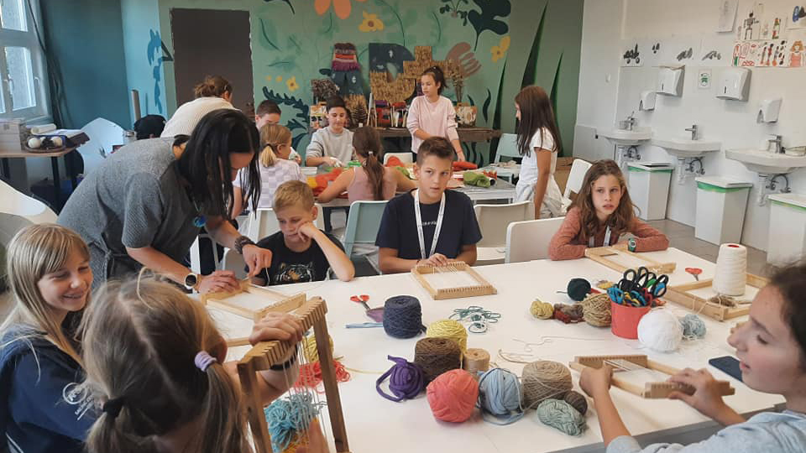
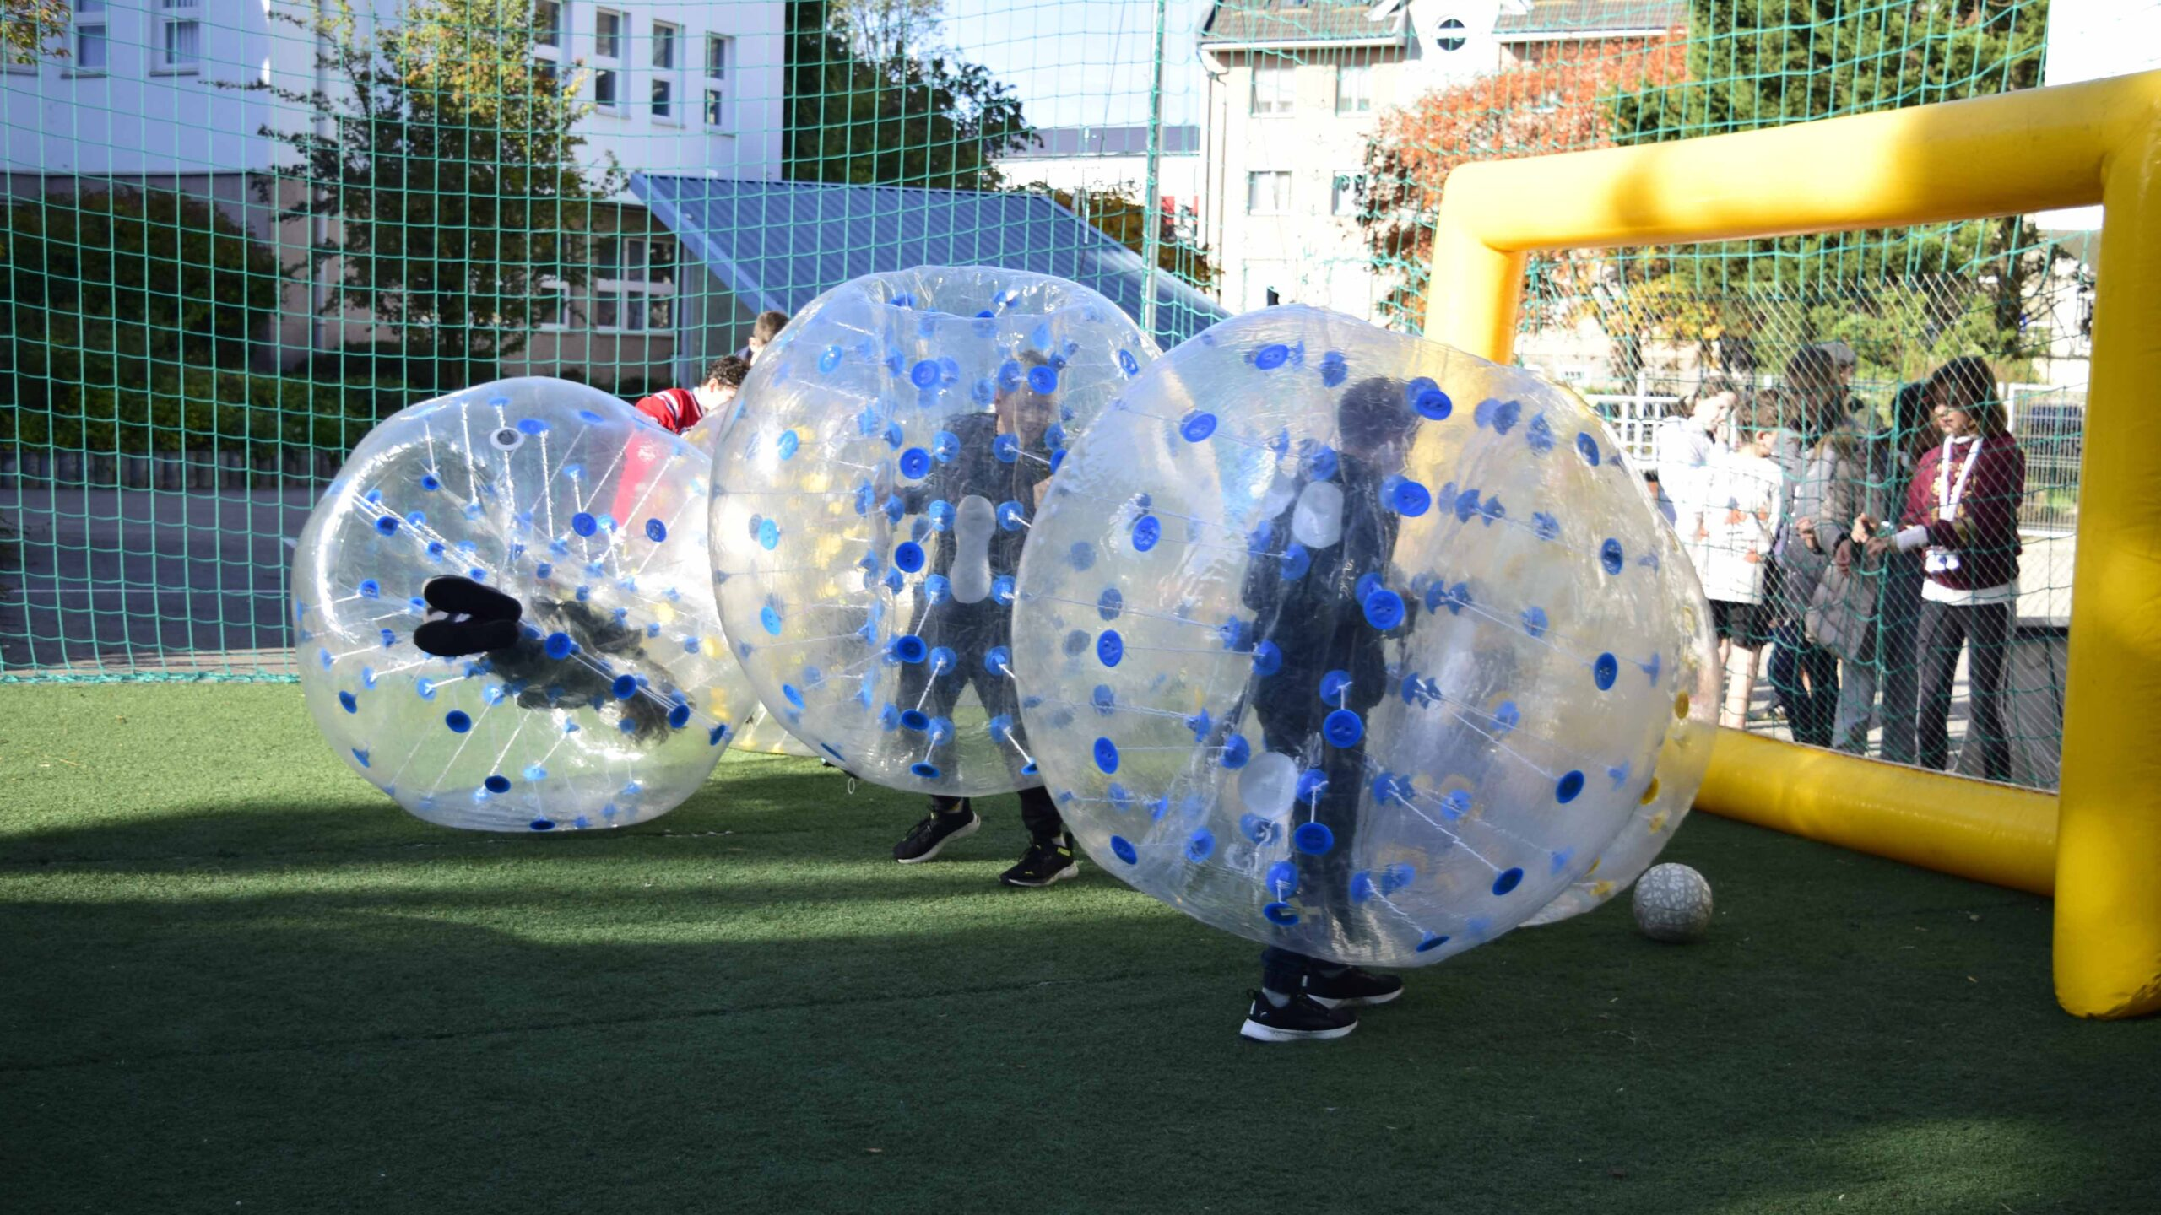
DÖK
Dök is a student law in the school. It is shortend for Diákönkormányzat which means student law. There have been dök days during the school years and they came up with some of the events eg.: halloween and dök days (of course).

Slide 4
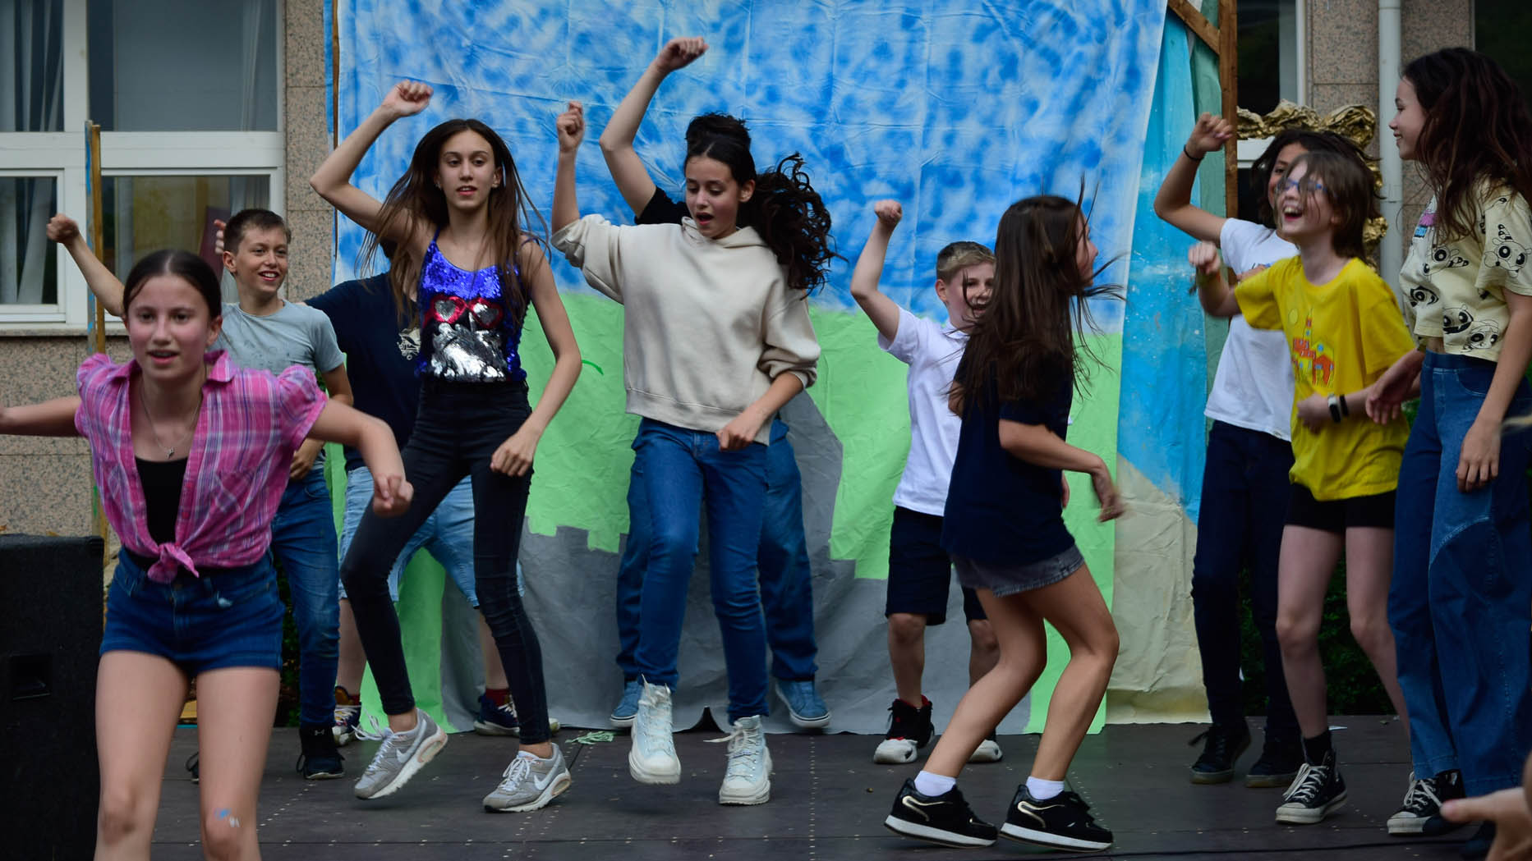
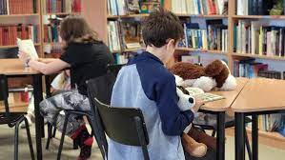
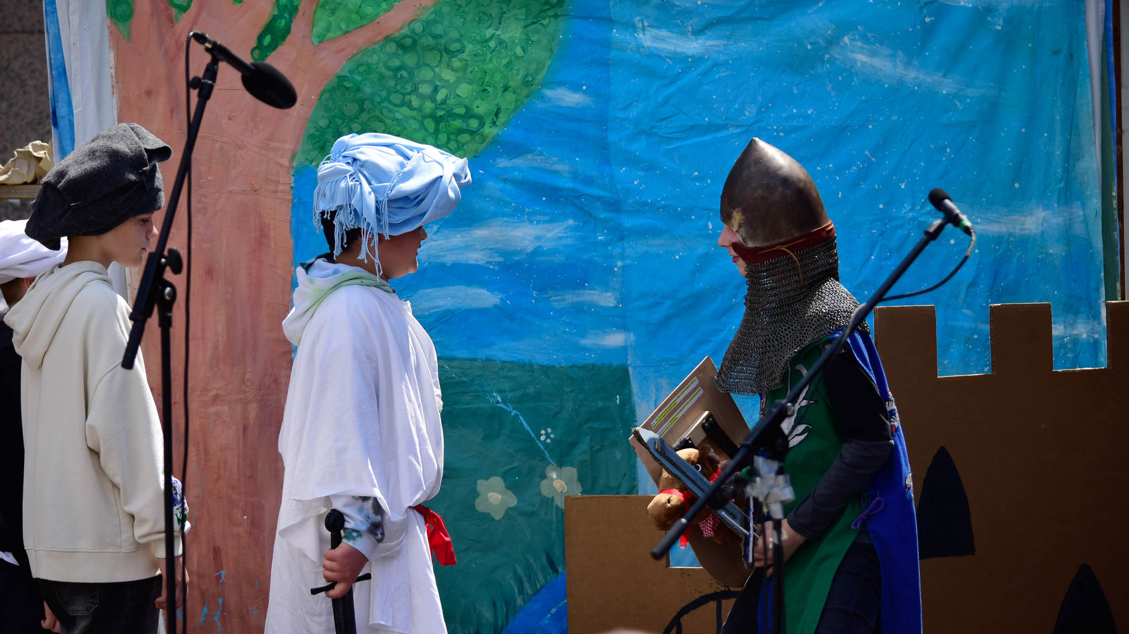
ARTISTIC WEEKs
We have had several artistic weeks during the years and we renovated the school library.

Slide 5
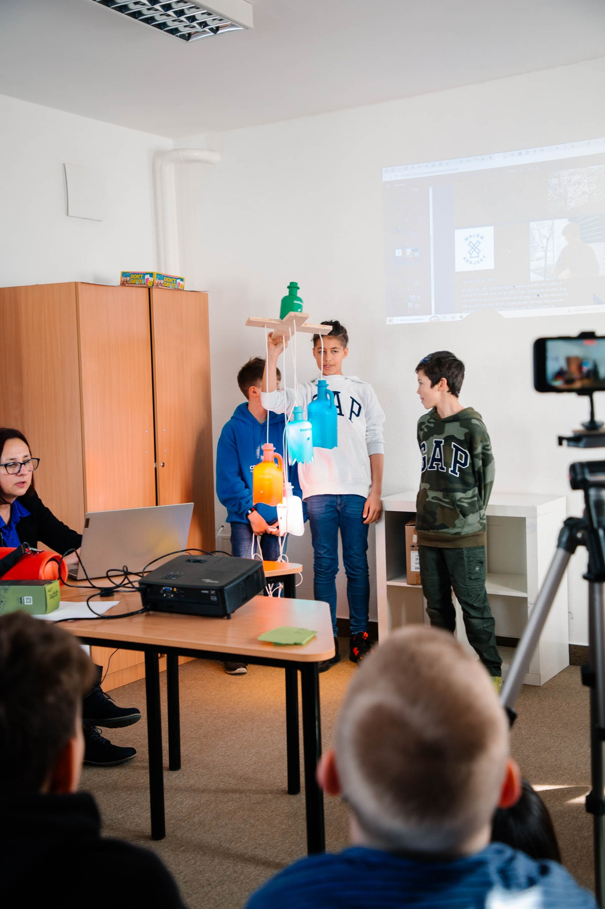
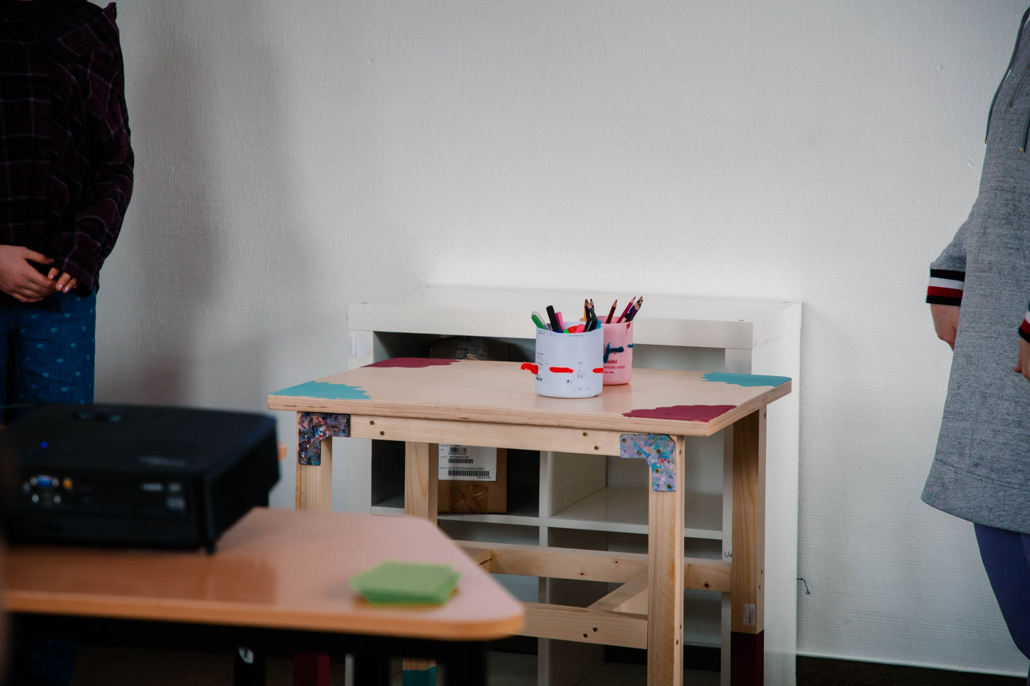
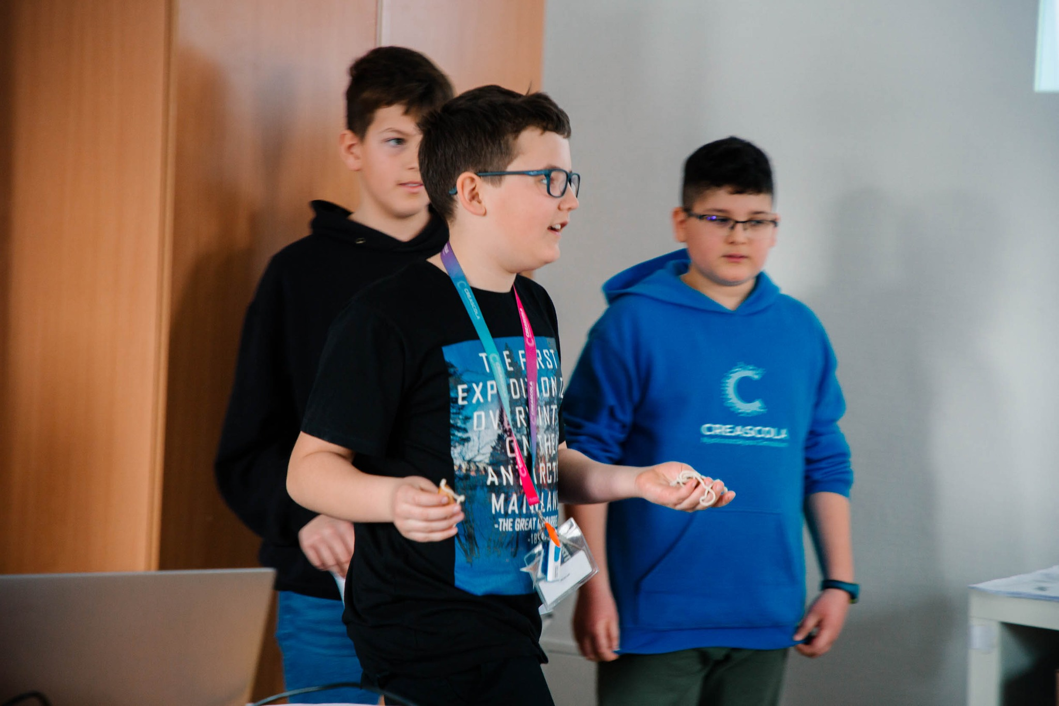
Nature friendly week
There has been an eco not ego week which was similar to the artistic week but we were set in groups of either 2 or 3 and we used up plastic to make stuff like tables lamps out of used detergent tubes. There was a man called Adam who helped us during this project.

Slide 6
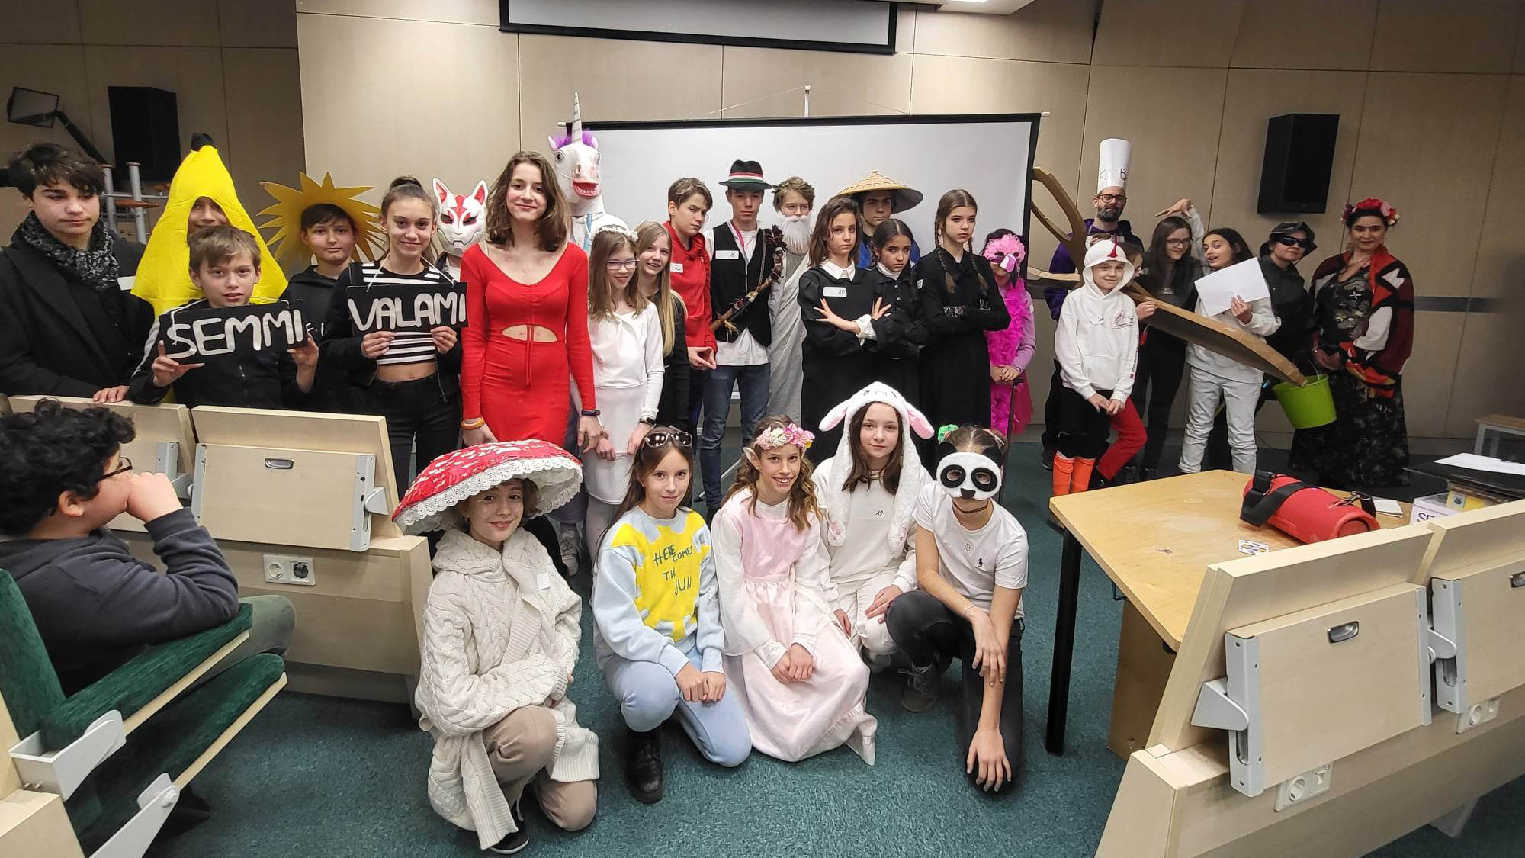
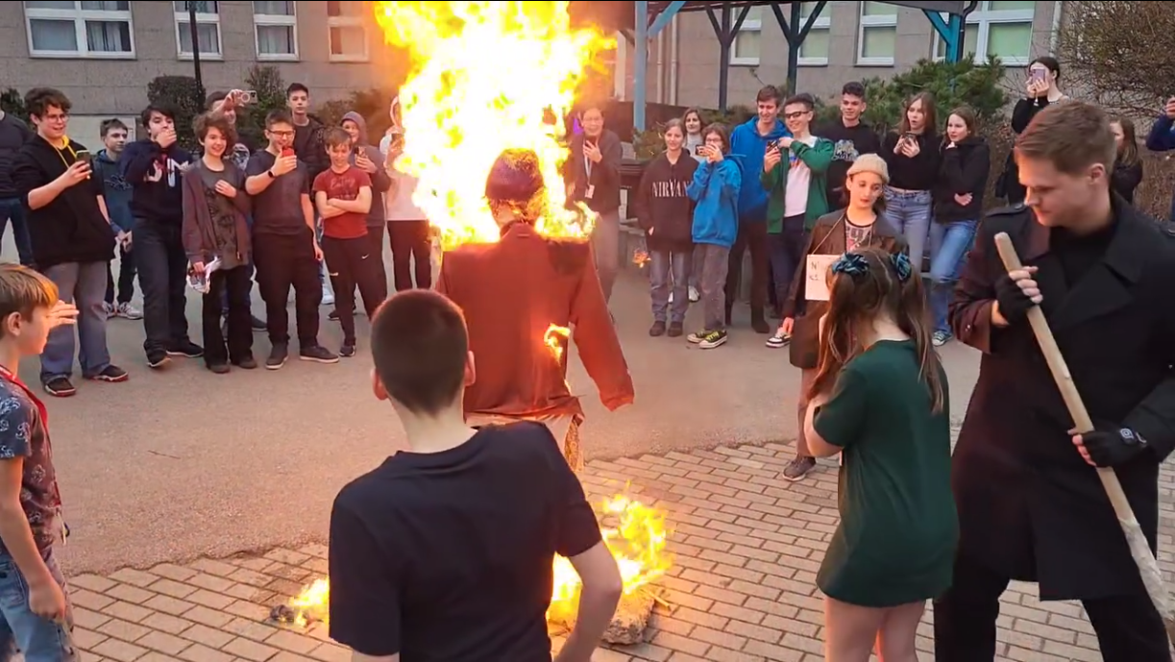
Farsang
In hungary we have farsang which is a festival where all the kids dress up in different costumes. After the day we set a FAKE doll on fire which we believe in that the winter will go away. This picture is when it was this year just on Friday 2 weeks ago. The kids who are setting it on fire are the ones who won the best costumes.

Slide 7
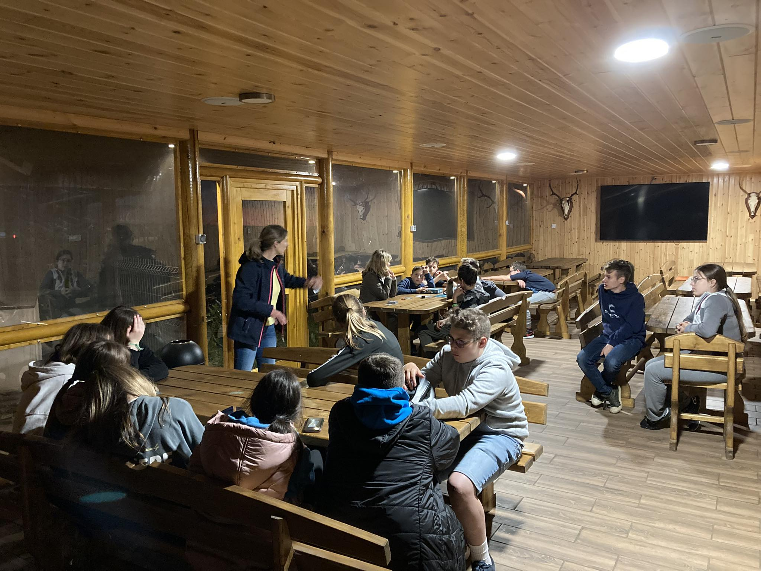
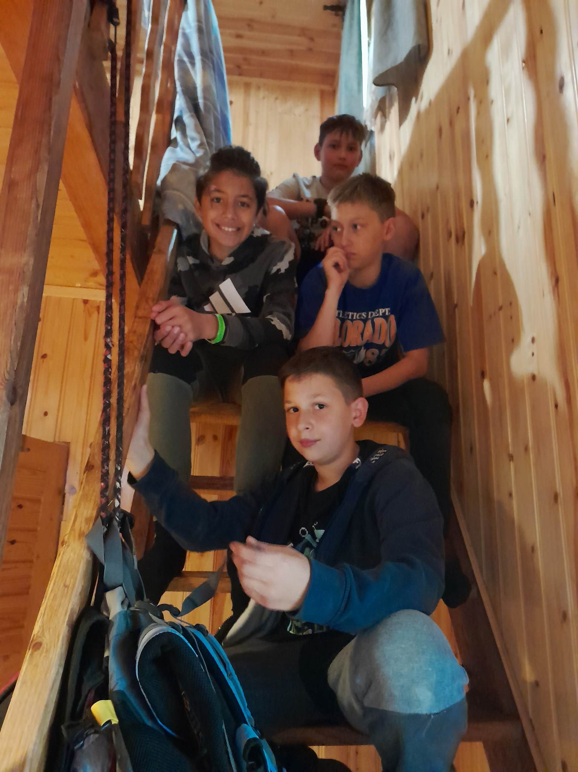
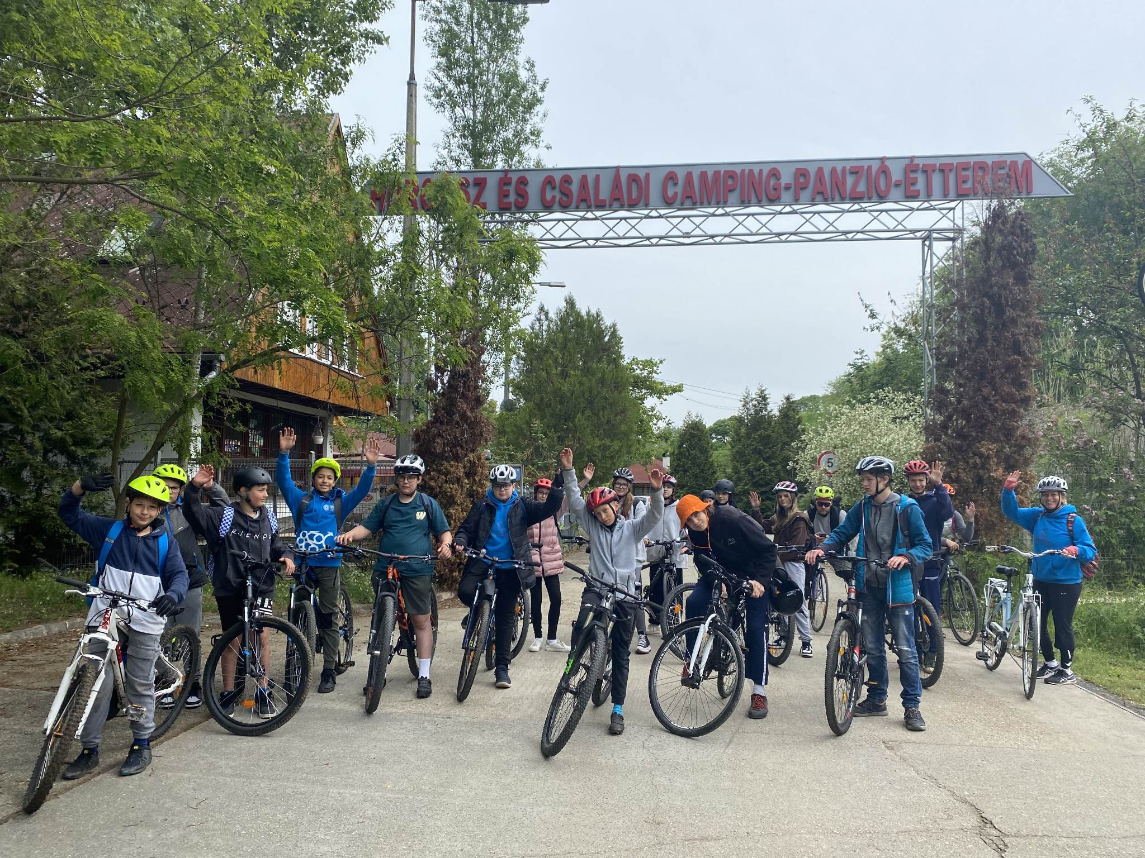
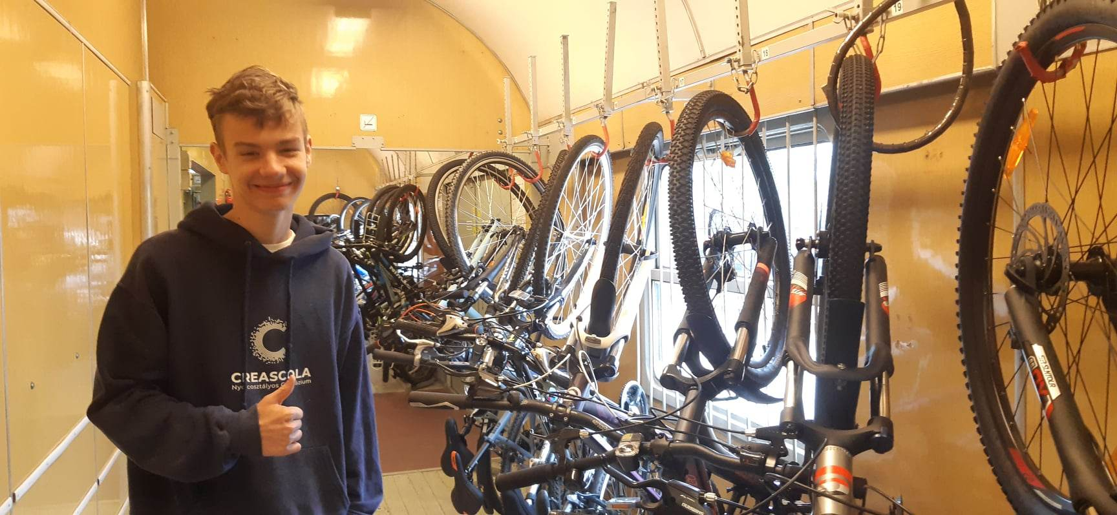
Bicycle camping
Kids could go to a bicycle camp for weekend where we cycled 70km. Both Adam and Ivan went to this camping with our friends.

Slide 8
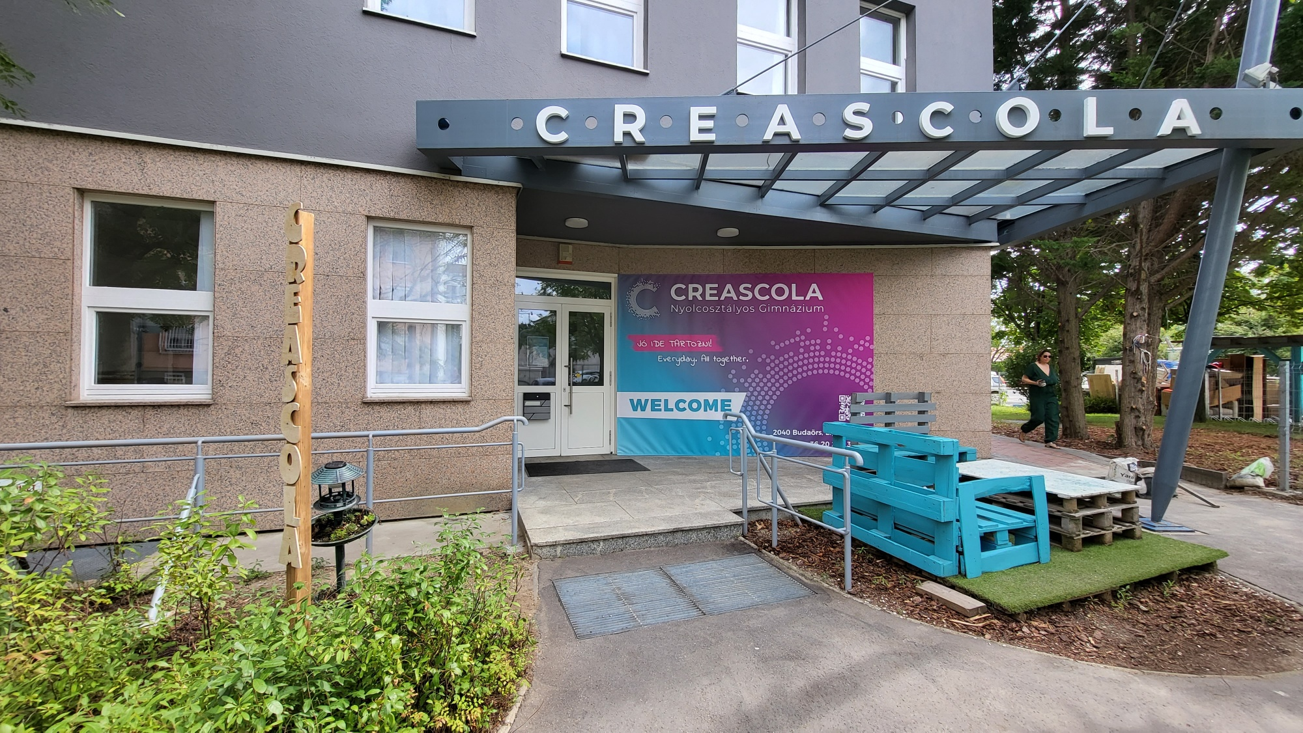
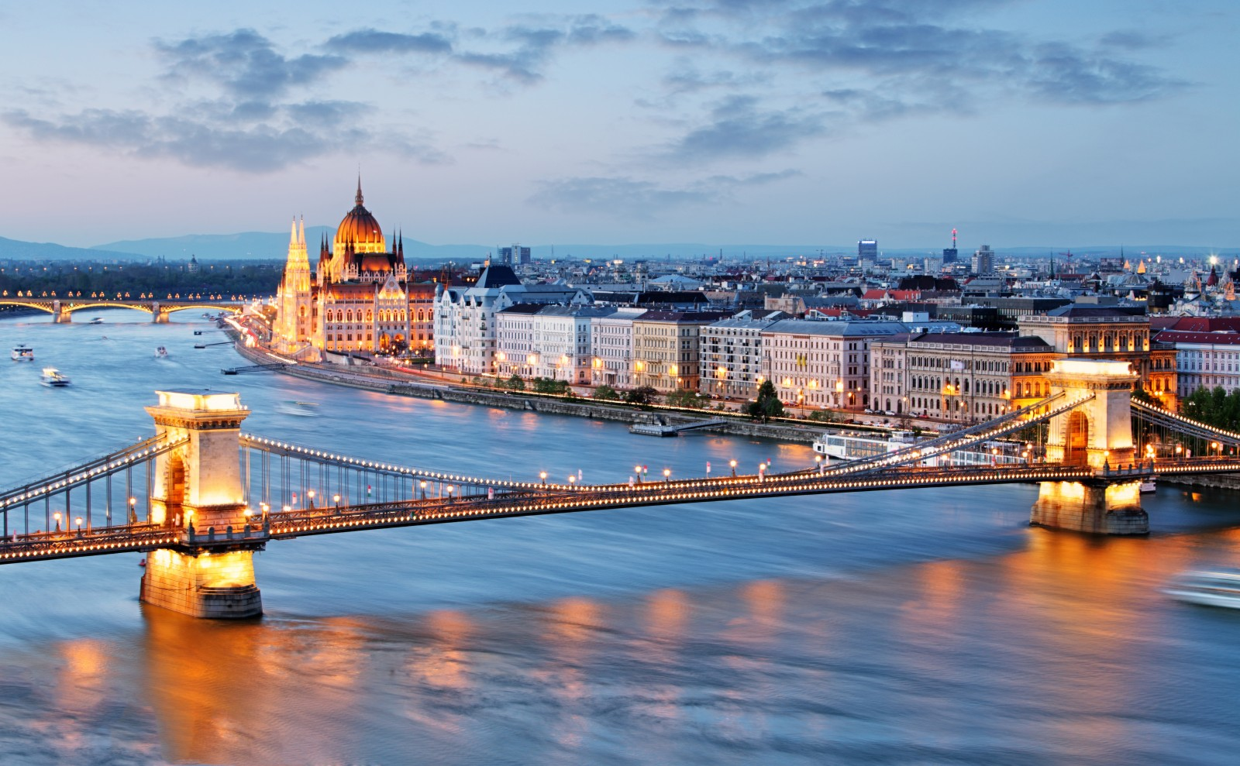
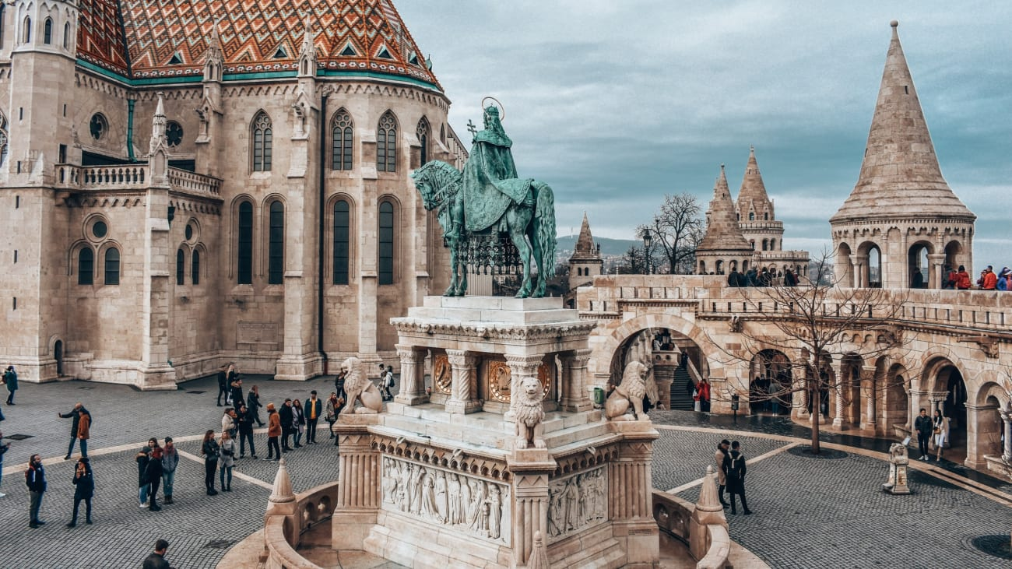
Thank you for your attention
bye

